Slide 1


Medicare Provider fraud detection
Juan zhu

Slide 2
WHY ?
US spends $4.3 trillion on healthcare in 2021, accounting for 18.3% of the Gross Domestic Product (GDP). Each person costs $12,914 per year.
01
Medicare spends $900.8 billion, accounting for 21% of total national health expenditure (NHE).
02
Healthcare Fraud is estimated by the US Federal Bureau of Investigation to be 3% to 10% of overall spending.
03

Slide 3

Types of Healthcare Provider Fraud
Phantom Billing.
Unnecessary Services.
Upcoding.
multiple-billing.
Unbundling.
False price reporting.

Slide 4
Research Statement
Focus on healthcare fraud committed by provider.
Explore data analysis by using Medicare claims dataset.
Identify healthcare fraud indicators and fraudulent provider characteristics.
Build Machine learning classification models to predict potential providers.

Slide 5
Medicare claims datasets
Beneficiary
Beneficiary ID
Inpatient
Claim ID
Outpatient
Claim ID
Provider
Provider ID
Date of Birth
Date of Death
Gender
Race
Chronic Diseases Risk
Annual Reimbursed Amount
Annual Deductible Amount
Beneficiary ID
Provider ID
Admission Date
Discharge Date
Attending Physician
Operating Physician
Beneficiary ID
Provider ID
Attending Physician
Whether fraud
Claim Reimbursed Amount
Claim Deductible Amount
Claim Reimbursed Amount
Claim Deductible Amount
Diagnose Codes
Procedure Codes
Diagnose Codes
Procedure Codes
Claim Start & End Date
Claim Start & End Date
Operating Physician
Other Physician
Admit Diagnose Code
State
County
Other Physician
Diagnose Group Code

Slide 6
Workflow
Data Pre-processing
Data cleaning;
Exploratory Data Analysis
Class label
Beneficiary Basic Information study
Fraud vs. non-fraud provider study
Exploratory Base Algorithm
Pipeline : feature Selection +Classifiers;
Algorithm Comparison
Feature Engineering;
Feature Selection;
Imbalanced Data Resampling.
Optimization Model
Hyperparameter Tuning; Evaluate Precision, F1, Recall;
Maximize Recall;
Feature importance Explain.

Slide 7
DATA PREPROCESSING
Imputing
Missing Data :
Beneficiary:
Inpatient: Diagnosis/ Procedure codes
Outpatient: Operating physicians
Creating
New Features :
Deceased, Tot_Reimbursed_Amt, Hospital_Stay, Claim_Duration, Physician_Count, Claim_Count, Chronic_Disease_Count, Diag_Code_count, Diff_Reimbursed_SC, etc.
Dropping features:
Features with high null values;
Features from which new features were created, etc.
Integrating datasets
Label Encoding :
Data Scaling:
Robust-scaled: Due to the inclusion of outliers.
Handling Class Imbalance:
SMOTE, SMOTE +ENN.
Categorical features
Integrate beneficiary, inpatient, outpatient and providers datasets by merging/concatenating on the common columns.

Slide 8
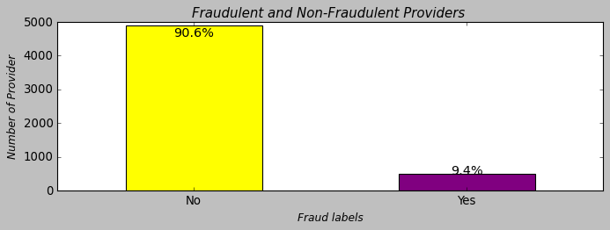
Exploratory Data Analysis 1. Class Label Imbalanced data

Slide 9
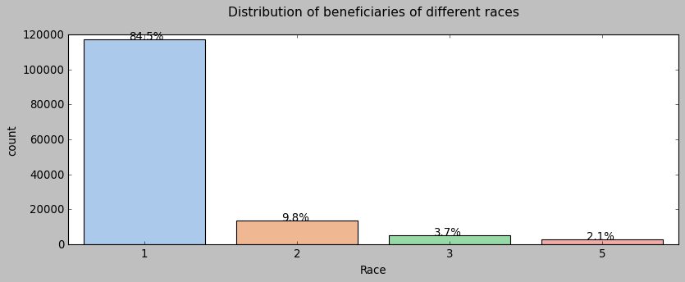
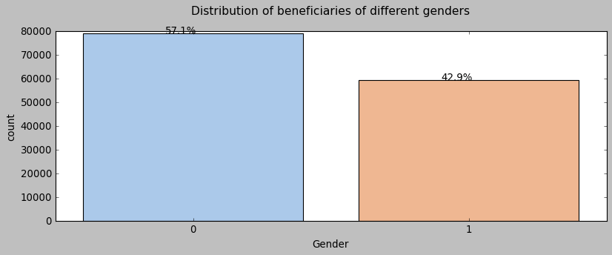
2. Beneficiary Basic Information Study

Slide 10
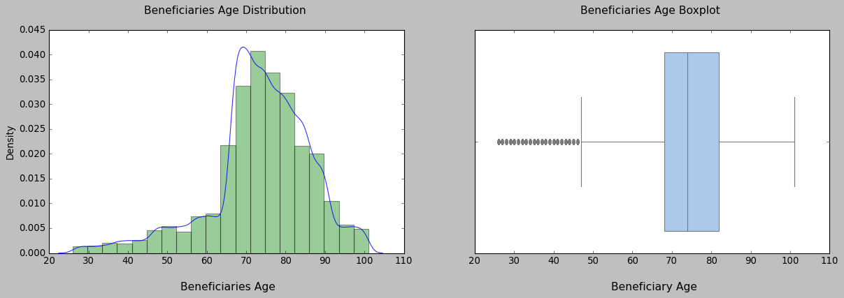
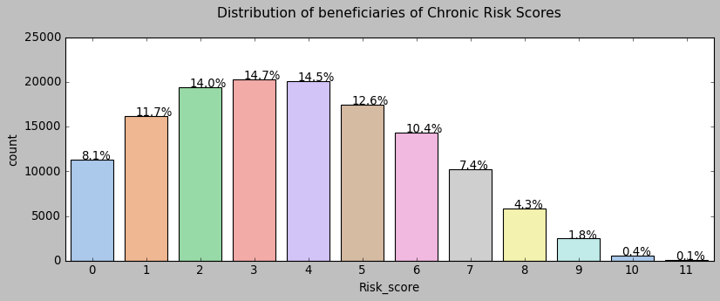
Beneficiary Basic Information (continue)

Slide 11
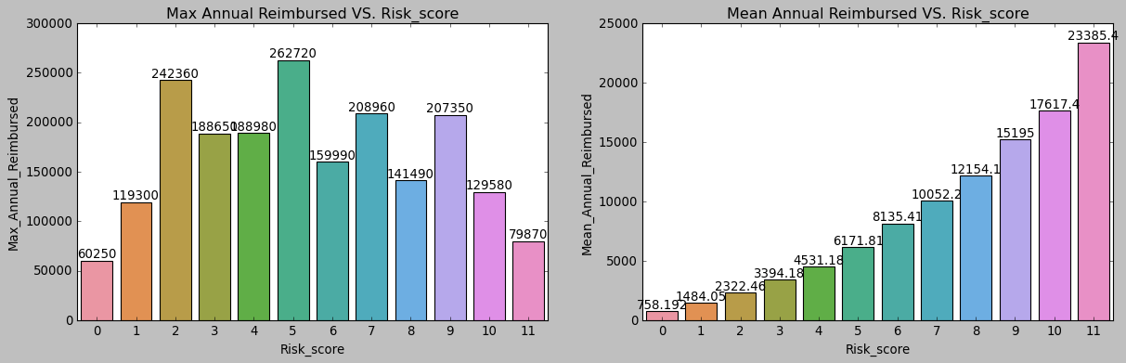
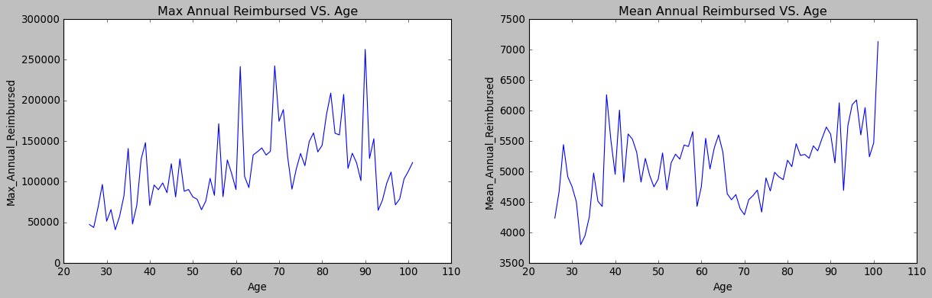
Beneficiary Basic Information (continue)

Slide 12
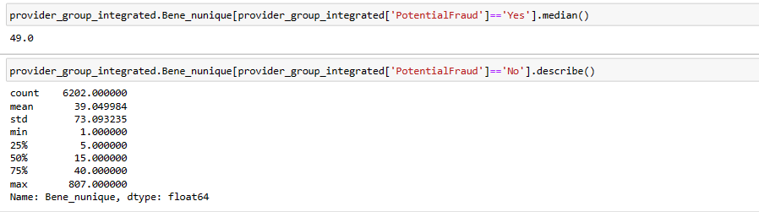
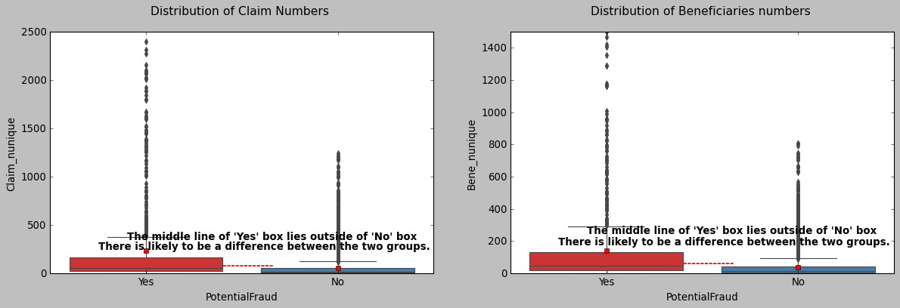
3. Fraud vs. non-fraud provider study

Slide 13
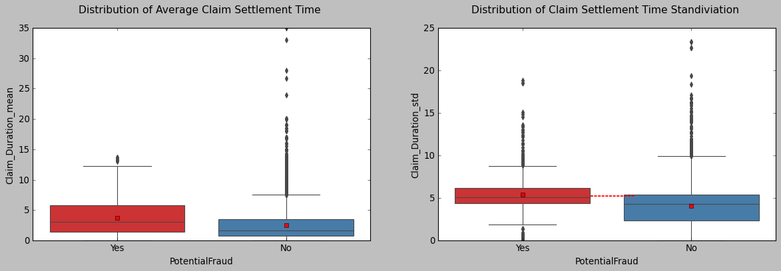
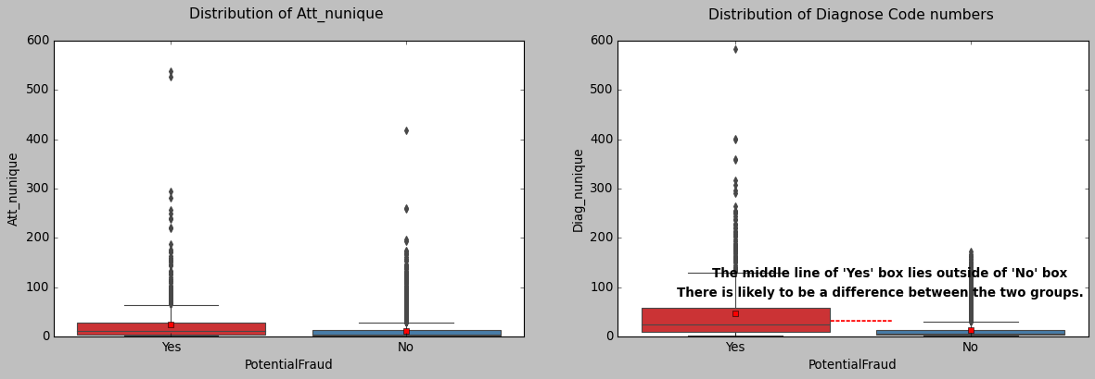
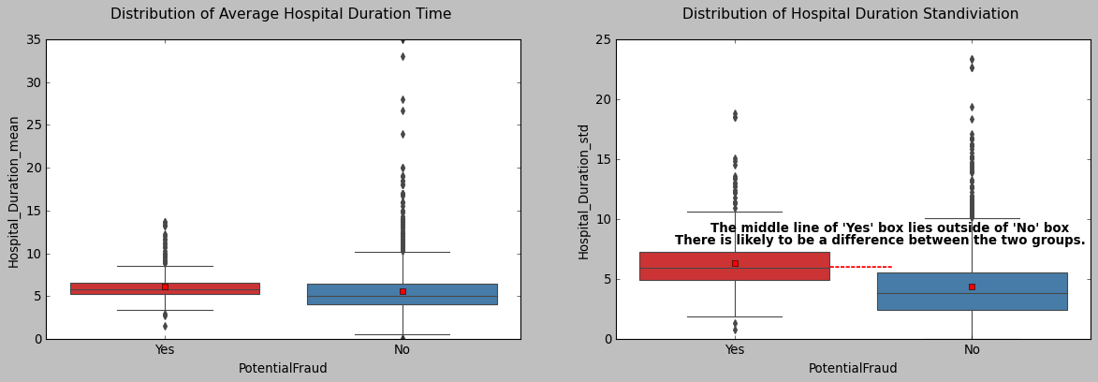
Fraud vs. non-fraud provider study (continue)

Slide 14
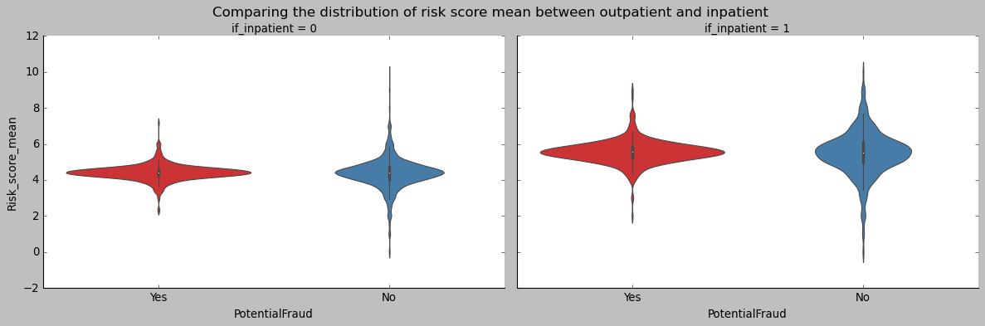
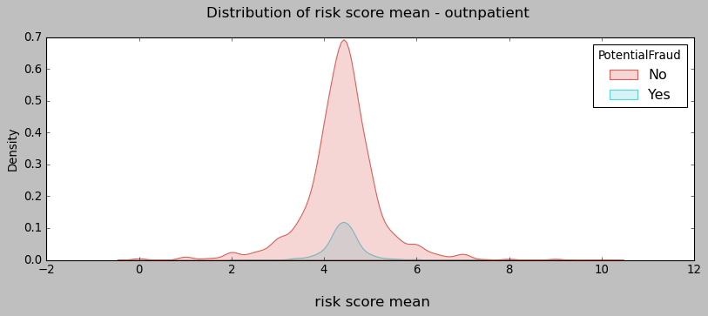
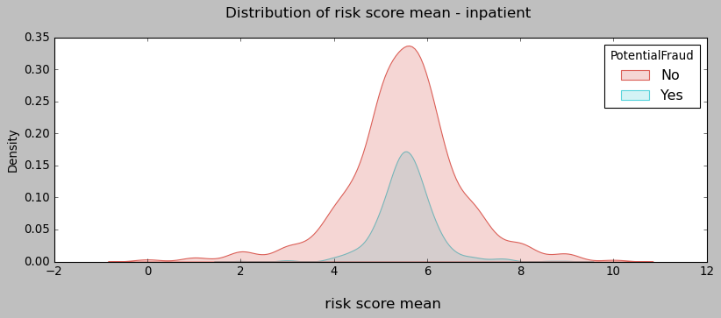
Fraud vs non-fraud provider study (continue)

Slide 15
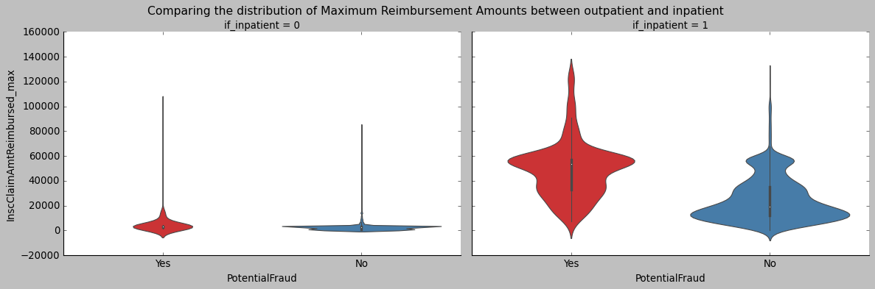
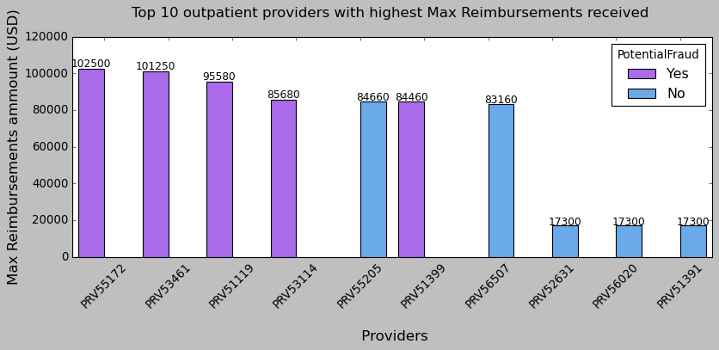
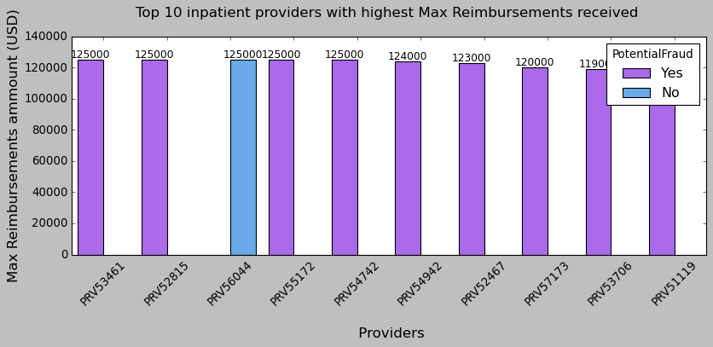
Fraud vs non-fraud provider study (continue)

Slide 16
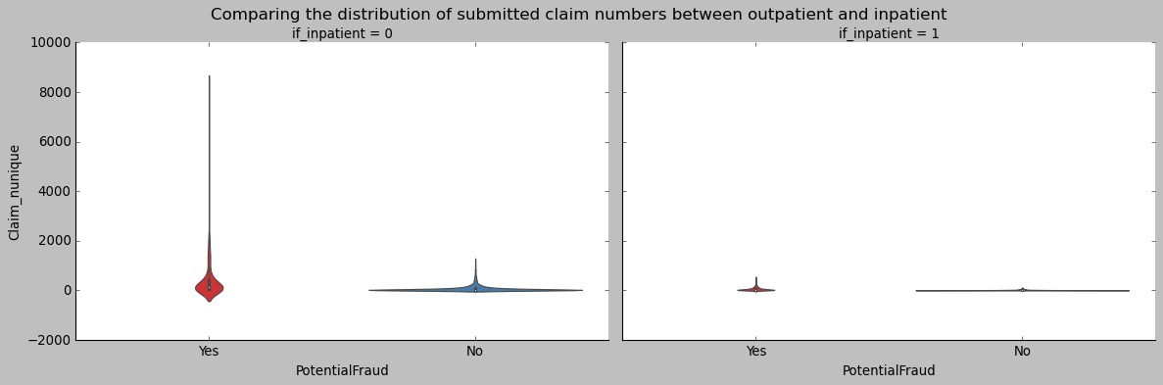
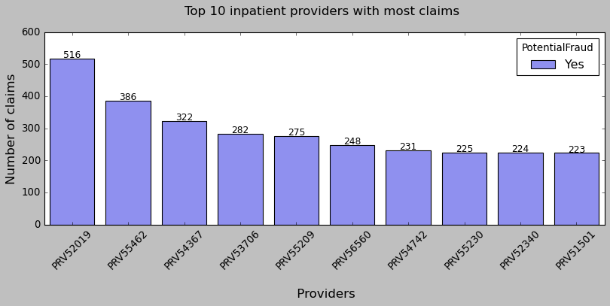
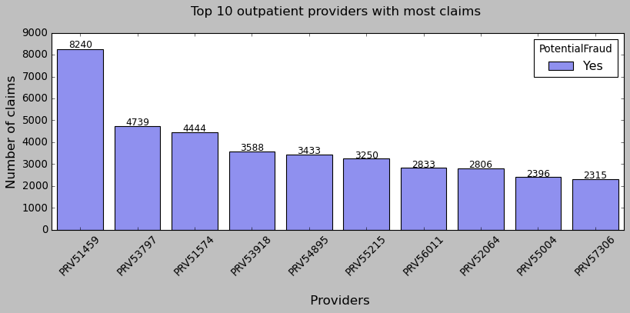
Fraud vs non-fraud provider study (continue)

Slide 17
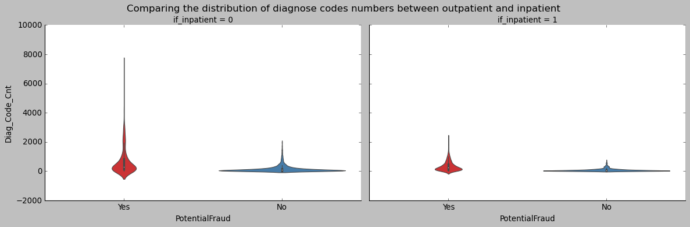
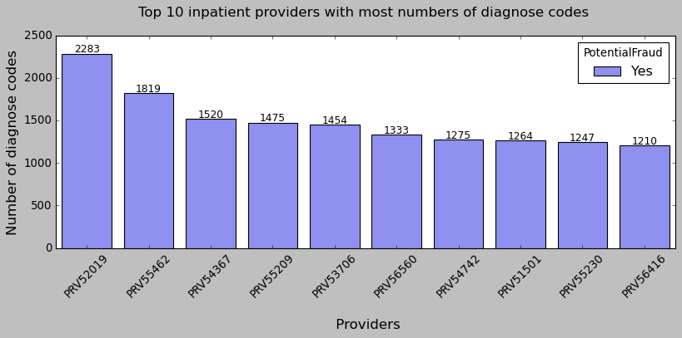
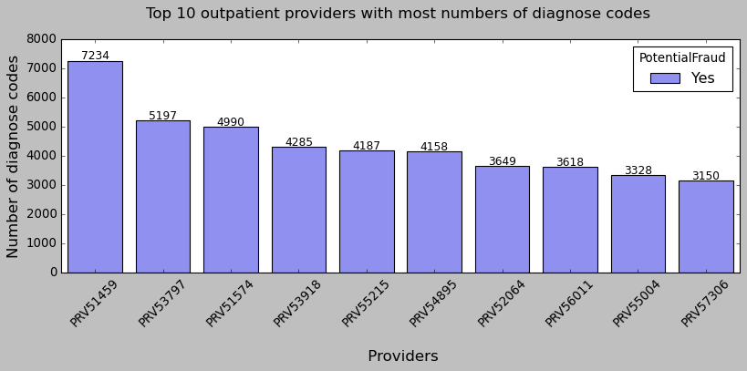
Fraud vs non-fraud provider study (continue)

Slide 18
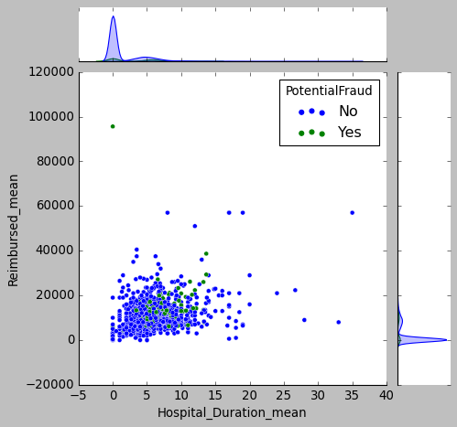
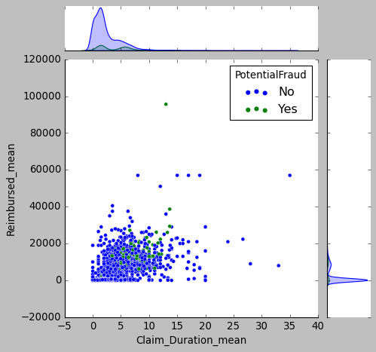
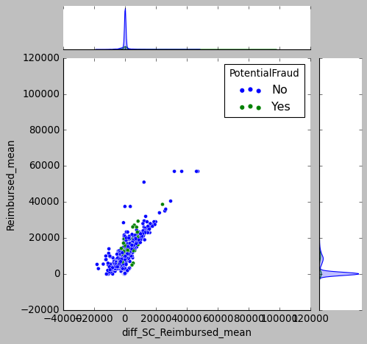
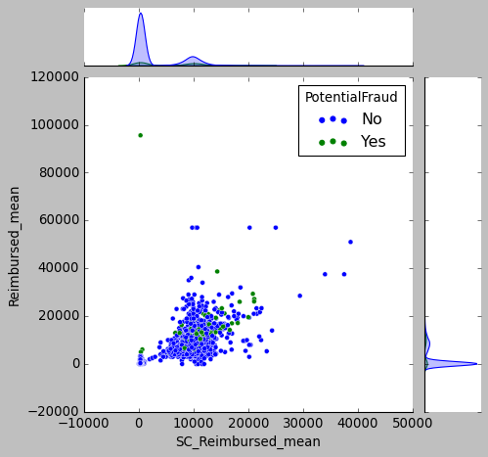
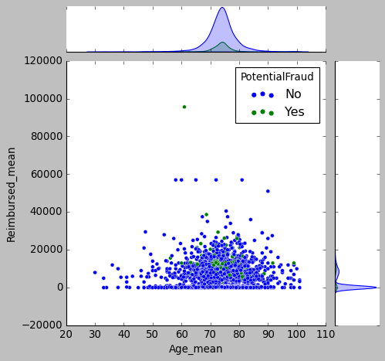
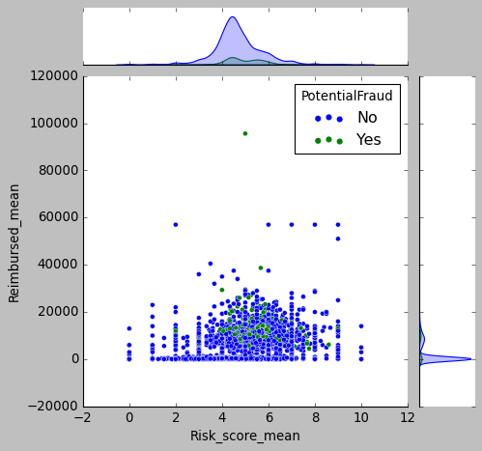
Fraud vs non-fraud provider study (continue)

Slide 19

Data Modeling
Data set
Testing set
Models
Split
Training set
Val
Trn
Trn
Trn
Trn
Model
Construction
K Fold
Cross Validation
Pipeline model
Logistic Regression
Support Vector Machine
Random Forest
Gradient Boosting
LightGBM
CatBoost
XGBoost
Results
Recursive Feature Elimination
Model Performance Evaluation

Slide 20
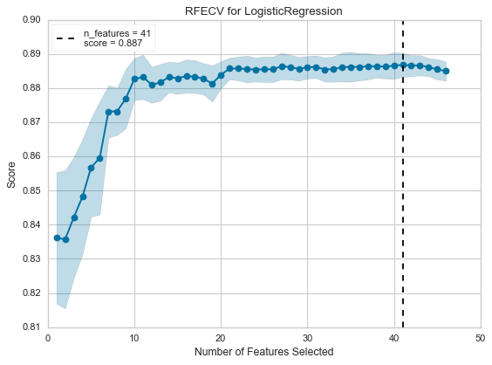
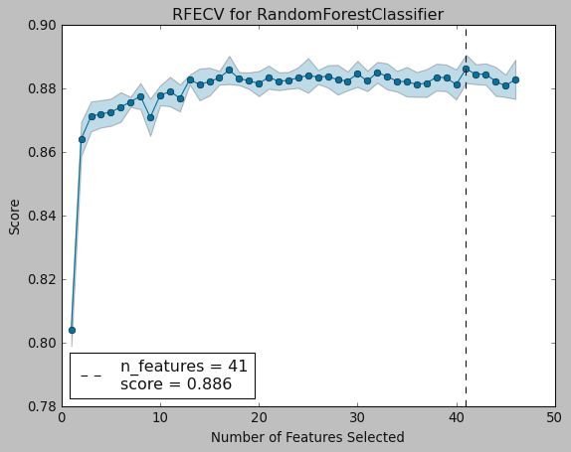
Feature Selection

Slide 21
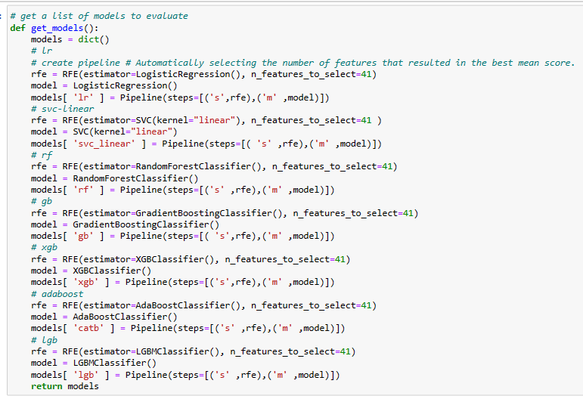
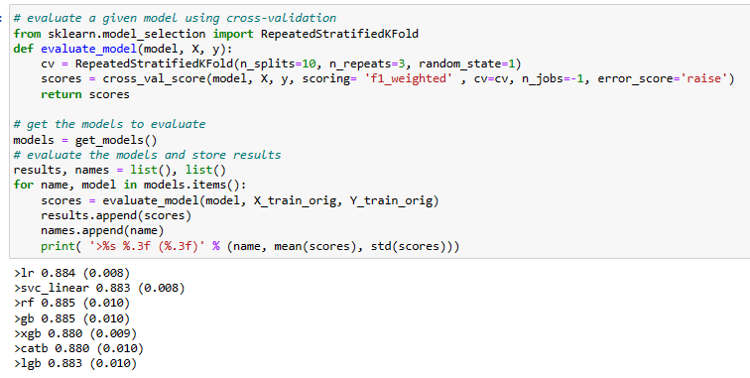
Explore Base Algorithm

Slide 22
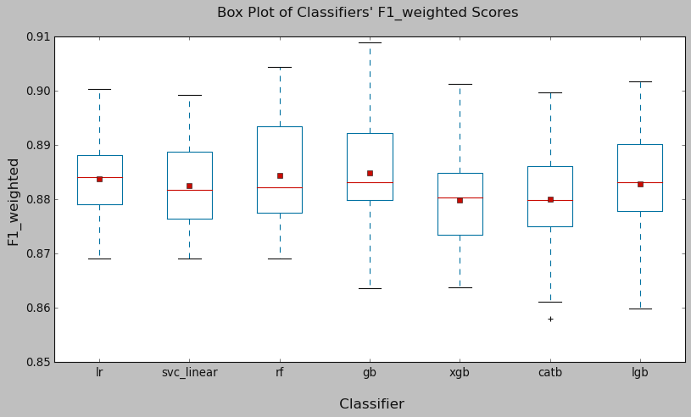
Base Algorithm comparison
Logistic Regression, Support Vector Machine, and Random Forest classifiers generally perform well. While the mean performance of the Gradient Boosting classifier appears good, its F1_weighted score has a relatively larger variance compared to the others. This may result in less stable results.

Slide 23
Optimization Models
Select Model
Procedure
Review Parameters Search Space
Hyperparameter Tuning
Select Search Method
Cross Validation
Evaluation Metrics
for Imbalanced Data
Precision: When minimizing false positives is the focus.
Recall: When minimizing false negatives is the focus.
F1: Express both concerns with a single score
Evaluation Model
Improve Recall to Minizine False Non-Fraud Provider
SMOTE
SMOTE+ENN

Slide 24
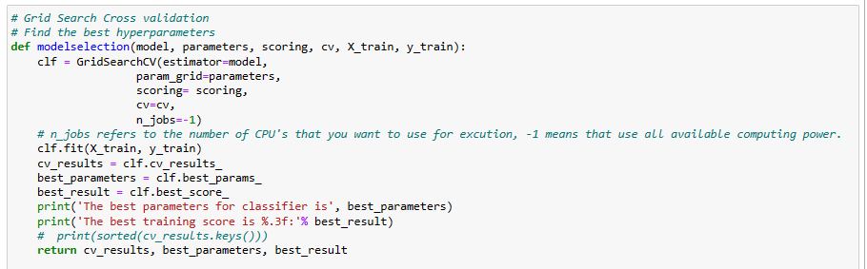
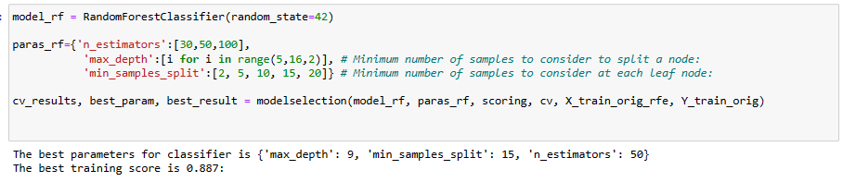
Hyperparameter Tuning

Slide 25
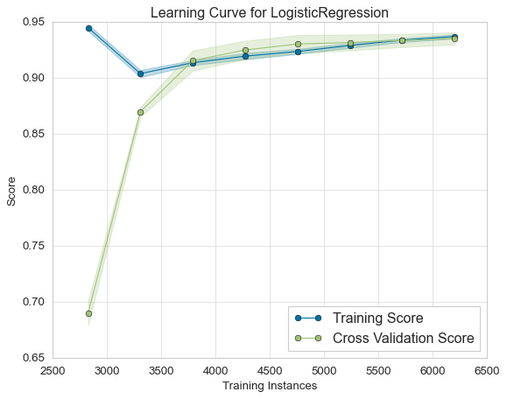
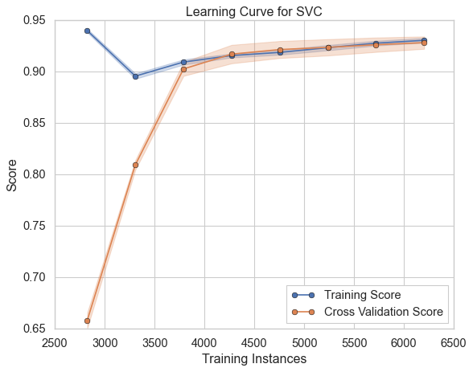
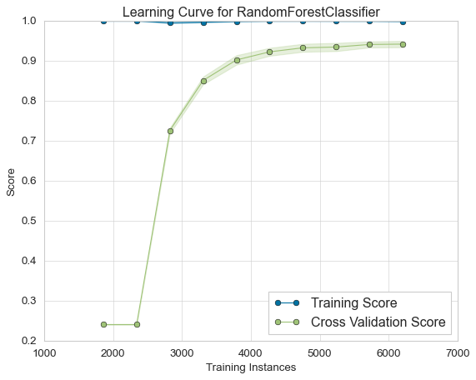
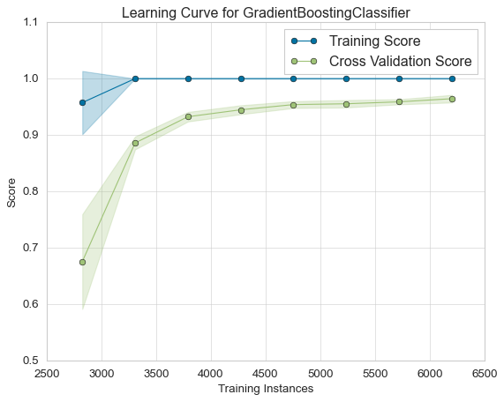
Learning Curve

Slide 26
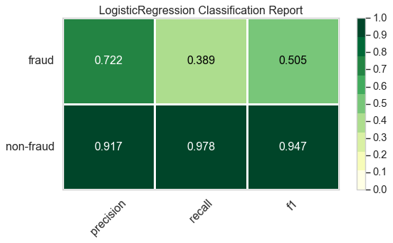
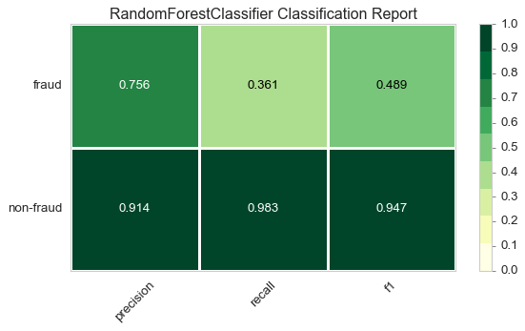
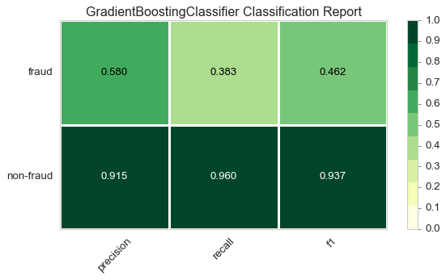
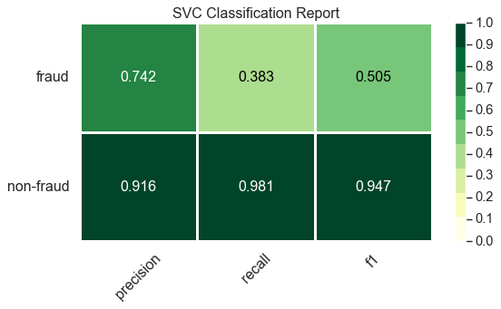
Precision, Recall, F1-score for Models

Slide 27
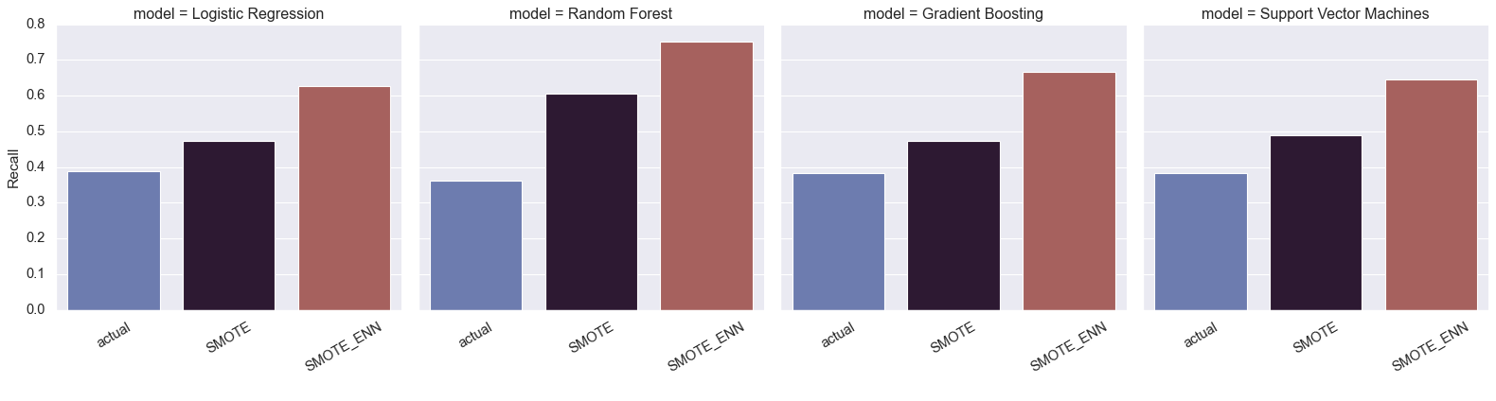
Maximize Minority’s Recall by using SMOTE Techniques

Slide 28
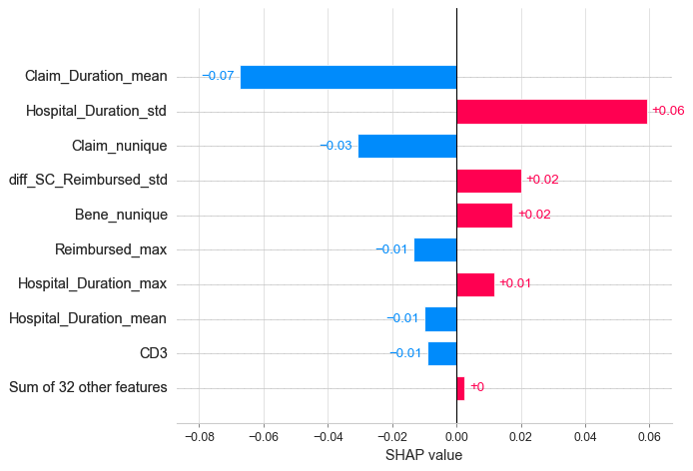
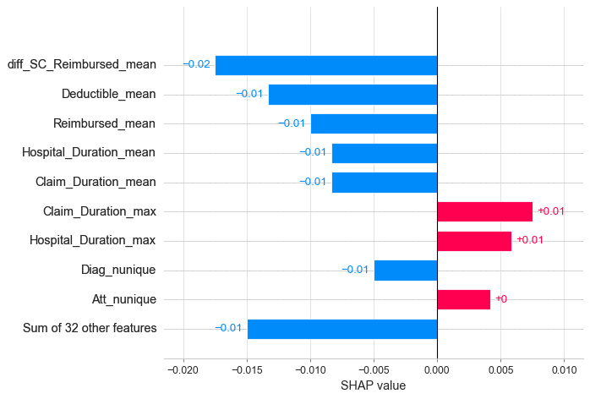
Feature importance: SHAP value for class 0
Logistic Regression Model:
Random Forest Model:

Slide 29
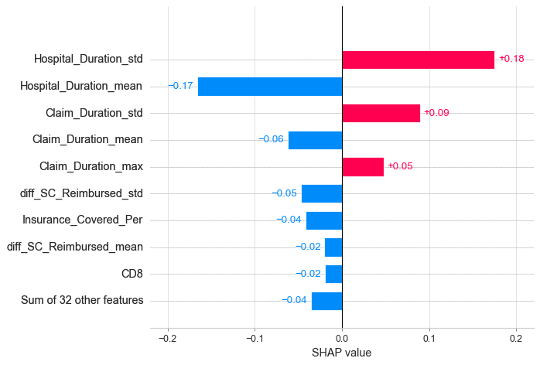
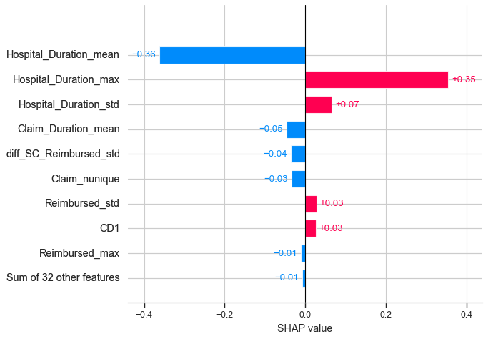
Feature importance:
Gradient Boosting Model:
Linear SVM Model:

Slide 30
Conclusion
Possibly Fraud Providers | Non-Fraud Providers
High average claim settlement time with small variance | Low average claim settlement time with large variance
High average hospital duration time with small variance | Low average hospital duration time with large variance
High number of patient insurance claims | Low number of patient insurance claims
High average reimbursement | Low average reimbursement
High average deductible | Low average deductible
High difference of claim reimbursement from county state mean | Low difference of claim reimbursement from county state mea
Low number of Beneficiaries | High number of Beneficiaries
High number of diagnosis codes listed on claims | Low number of diagnosis codes listed on claims
Low number of Physician | High number of Physician

Slide 31
Reference
National Health Expenditure Data from https://www.cms.gov/Research-Statistics-Data-and-Systems/Statistics-Trends-and-Reports/NationalHealthExpendData/NHE-Fact-Sheet
Healthcare Provider Fraud Data from https://www.kaggle.com/datasets/rohitrox/healthcare-provider-fraud-detection-analysis

